Slide 1
ESM and activity monitors
Yoram Kunkels (UMC Groningen)
Aki Rintala (KU Leuven)
24/11/2017
Belgisch-Nederlands ESM Netwerk

Slide 2
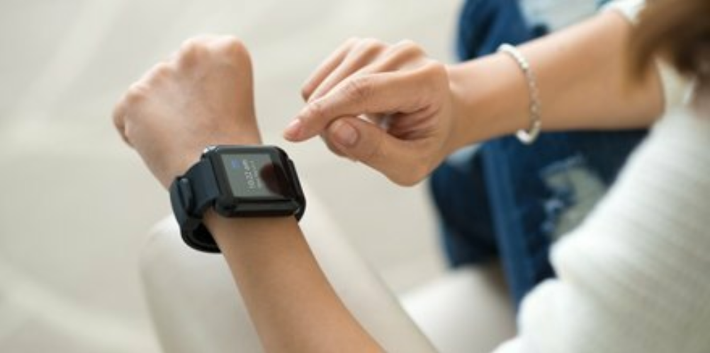
Content
Introduction to activity monitors
Data examples
Hands-on session
Discussion

Slide 3
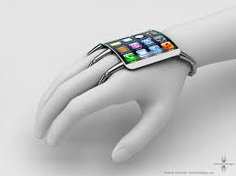
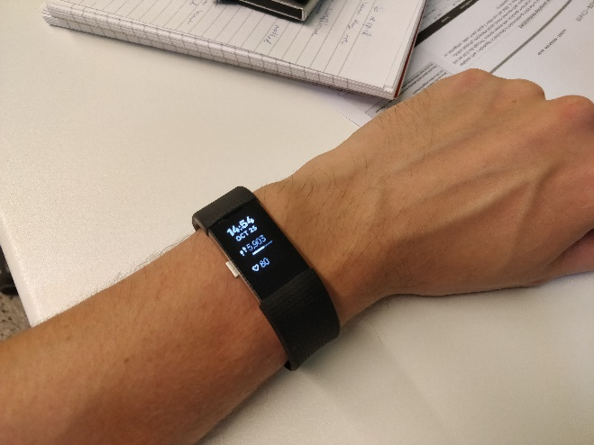
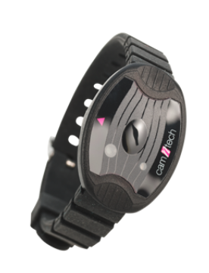
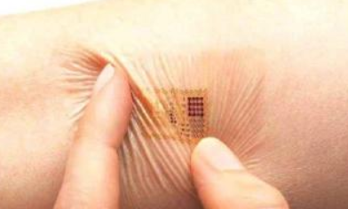
“…we have come a long way baby…”
INTRODUCTION
What is the future?

Slide 4
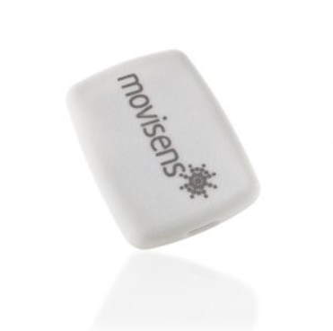
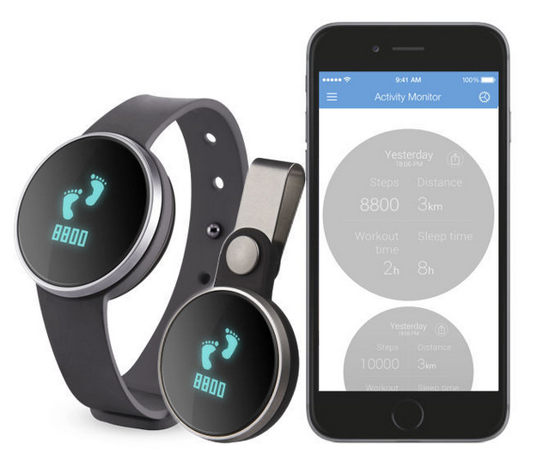
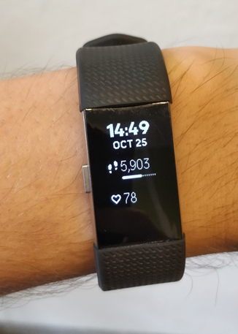
What is an activity monitor and what kind of devices are there?
Wrist
Ankle
Thigh
Waist
Motion8
iHealth Edge AM3s
FitBit

Slide 5
Why use passive momentary assessments (pMA)?
If interested in objective data related to e.g.,
Leisure time/ leisure activity
Physical activity
HR/HRV
Sleep
24/7 monitoring of daily life – continuous data

Slide 6
Why and when use pMA with ESM?
Behaviour mechanisms related to activity?
Feelings/emotions related to the moment of movement/activity?
Different associations of pMA and ESM features?
Objective vs. subjective data in stress/activity?
Methodological aspects?
=> Lets brainstorm these later on in the discussion part!

Slide 7
Device selection
Notes:
So what device we should then choose? The next slides we will present some examples and tips for the device selection process.

Slide 8
Goals
Device testing & feedback
List of devices
Data
User
Device selection
Study
Notes:
Here is one example of the methodology how the device selection can be done. For the device selection, there are certain issues such as goals, data, study protocol, user experience, and the technologies itself.
Goals in this contexts mean the study aims, hypotheses, and research questions that will help you to guide the device selection process. Also a bit related to that is the data - What you want to capture? Also one thing is crucial is the study design, for example are you conducting an interventional or observational study? For example this FitBit what I am using at the moment gives me real-time information on my steps, heart rate, walking distance, calories, steps in the stairs, and how many days I have been active since the last 7 days. So the device might give quite a lot of information to the participants during a study so if you are not planning to intervene in their daily lives, this should be taken into account.
User here means basically two sides: the feedback itself from a representative sample of your target population but also it might be the pre-knowledge that you already have from your targeted population on wearing the devices. For example cognition level or physical impairments might be important factors to consider when choosing a device.
List of technologies is recommend by first gathering what is out there and then starting to make comparison of the devices based on your previous experiences and literature. I will give an example of this in the next slide. Then it would be good the give some time for testing the narrowed list of the devices in more concrete and get feedback either from some test persons, or from yourself, or from other collaborators that you might have in your study. Those might guide your device selection a bit more for your study needs.

Slide 9
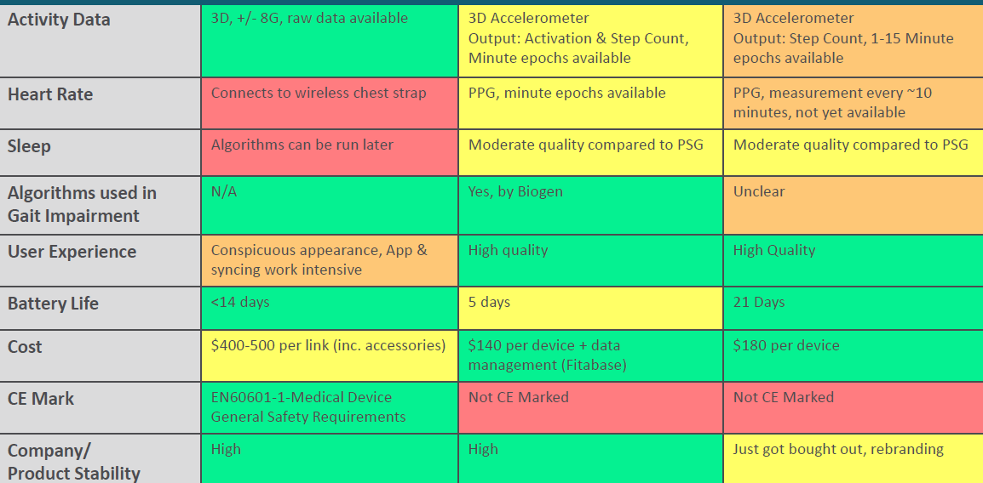
Device testing & feedback
DEVICE 1
DEVICE 2
DEVICE 3
Example taken from one international consortium decision tree
Notes:
Here is an example that illustrates some technical implementations that could guide the device selection process.

Slide 10
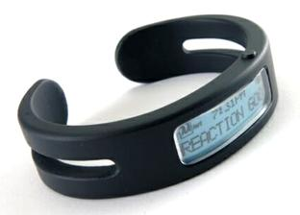
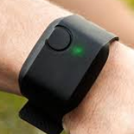
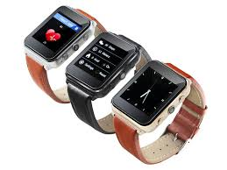
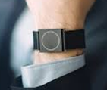
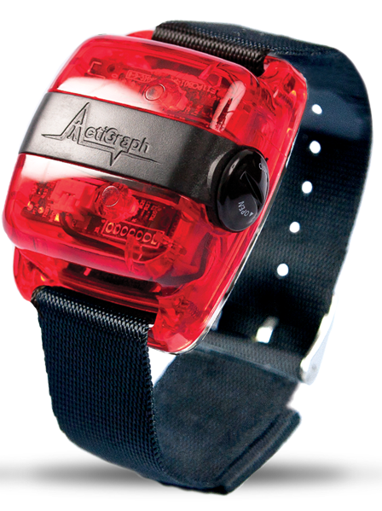
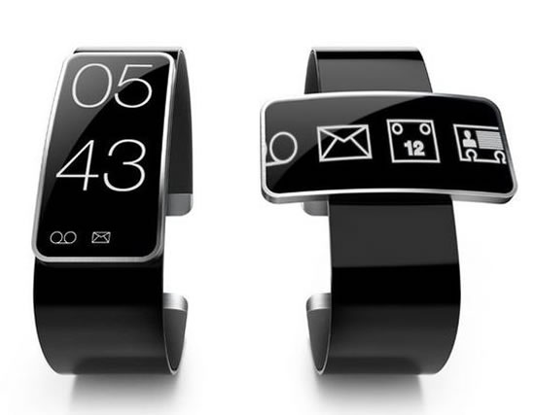
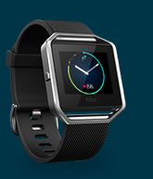
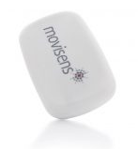
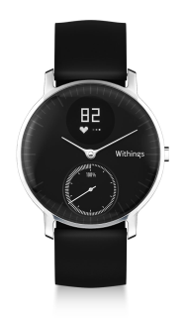
User experience (1/3)
Are these designed by men for men?

Slide 11
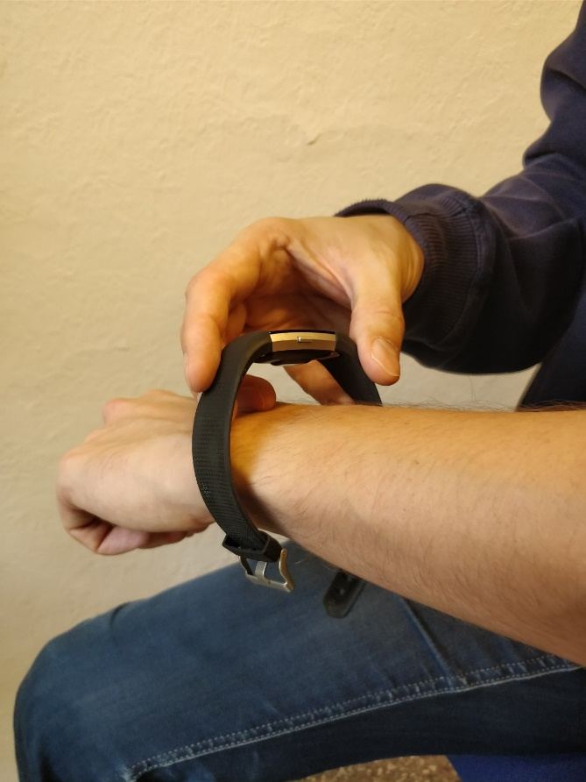
User experience (2/3) Design and the use are crucial parts…
In which contexts are they using the device?
COMPLIANCE | ADHERENCE | MOTIVATION | SELF-EFFICACY | MISSING DATA | QUALITY OF THE DATA
How participants’ want to use the device?
Are participants capable of wearing the device?

Slide 12
User experience (3/3) Tips for the device selection and making sure of the use during the study
Ask the feedback from the participants
Before the study
e.g., patient advisory board or focus groups
Also the experience of previous use of technology (maybe even a criterion for recruitment phase?)
During the study
Depends on the length of your study
Monitor user experiences
Validated/non-validated questionnaires (e.g., PSSUQ / TAM-FF)
After the study
Final evaluation of the user experiences – also one part of you results and increases the feasibility of your study protocol!
Plan carefully actions “what if”
Notes:
Roughly you can divide the feedback in 3 steps: the main thing is to make sure that you somehow involve participants or the targeted population to wear the device so that they feel that they’re opinions are listened. This might enhance the compliance of wearing the device and by monitoring the use of the device during a study is also a very important result of your study findings.

Slide 13
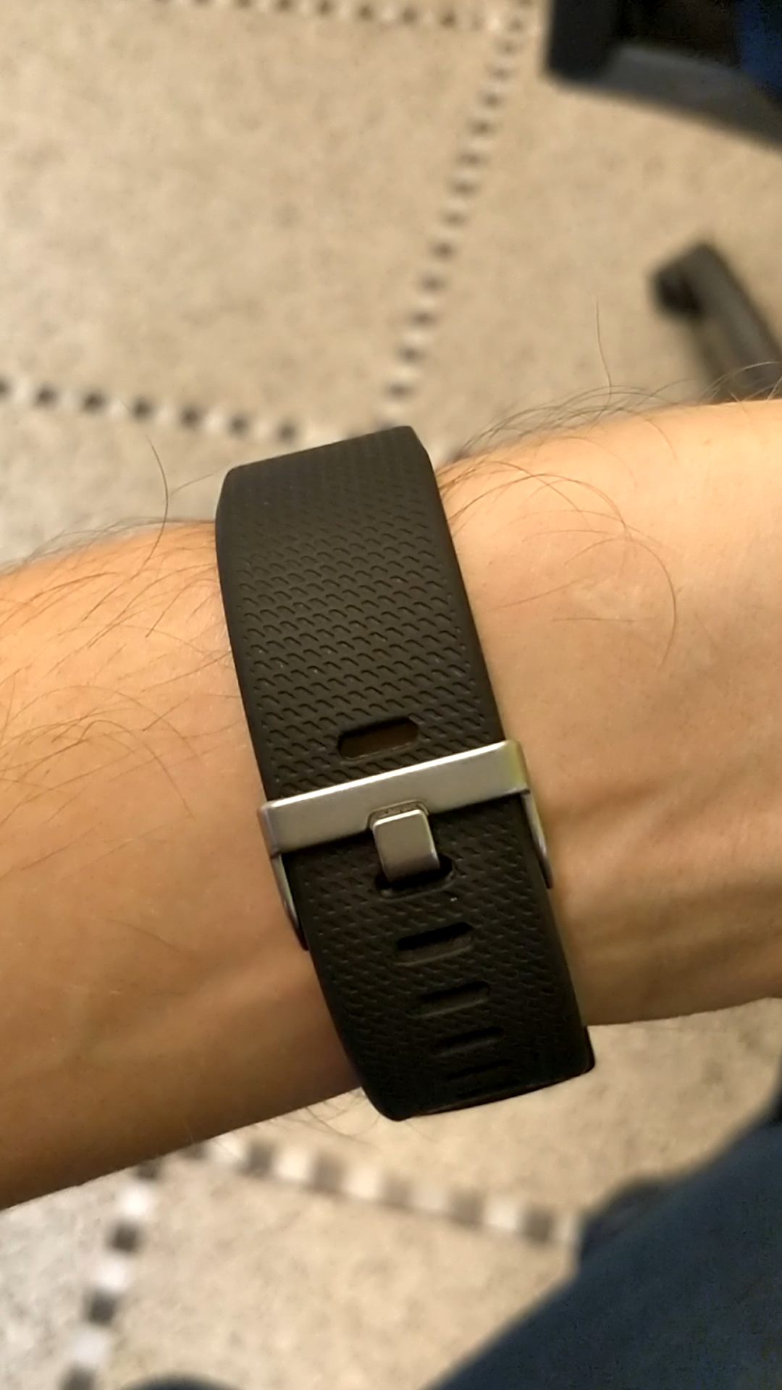
Battery life
Differs a lot between the devices: 4 to 24 days
WHY?
Not just because of the technical properties BUT also…
…some factors might influence on the battery life:
Frequency of transferring the data?
With or without screen display?
Using unnecessary features => avoid overuse?
Connection on/off (Bluetooth)?
Sufficient briefing/training session before the study!

Slide 14
Data transfer and features

Slide 15
DATA TRANSFER
Data access
Who has the rights?
Privacy issues?
Data storage
3º party server?
University server?
3º party data handling
What is transferred?
Company server?
How is it transferred?
Company rules?
In what format is it transferred?
WHO OWNS THE DATA? PARTICIPANT, 3º PARTY, OR YOU?
Notes:
Here is a simple example of the basic data transfer, but the main key points here is to make sure that everything is clear on the data ownership. So usually there is always some collaborators between the participant and a researcher, and all the company or country legislations needs to be carefully checked especially on the privacy issues and the data storage.

Slide 16
What features to extract – feeling like you’re walking in a swamp?

Slide 17
Million (?) options to choose from – IT’S A PUZZLE
Total amount of movement per day [counts]
Activity mean during sleep within valid time interval
Wake after sleep onset [min]
Brief Wake Ratio
Sedentary time [mins]
Sleep start [min after midnight]
Longest Wake Episode [min])
CHOSEN DEVICE, STUDY PROTOCOL, RESEARCH QUESTIONS AND HYPOTHESES WILL GUIDE YOUR SELECTION
Number of steps per day [steps]
Activity SD during sleep within valid time interval
Activity median during sleep within valid time interval
Mean walking step frequency [steps/minute]
Sleep Fragmentation Index
Percentage of sleep minutes in relation to whole considered time interval [%]
High Frequency (HF)
Maximum walking step frequency [steps/minute]
Low Frequency (LF) of HR
Number of awakenings / wake episodes [#]
Mean Sleep Episode [min]
Sleep Efficiency [%]
Sleep minutes [min]
Number of sleep episodes [#]
Longest Sleep Episode [min]
Mean Wake Episode [min]
Moderate-to-vigorous physical activity (MVPA) [mins]
Sleep Latency [min]

Slide 18
Best is to…
TRY FOR YOURSELF!
Notes:
And now Yoram will go through in more detail about the data related to the activity monitors. He will first go through a bit with the theory and then we will have some time with hands-on practice. So take it away Yoram!

Slide 19
Actigraphy
workshop

Slide 20
Overview
Data: From Raw to generic data formats
Pre-processing
Analyses
Devices and Software
Practical demonstration of MotionWare and ACTman software

Slide 21
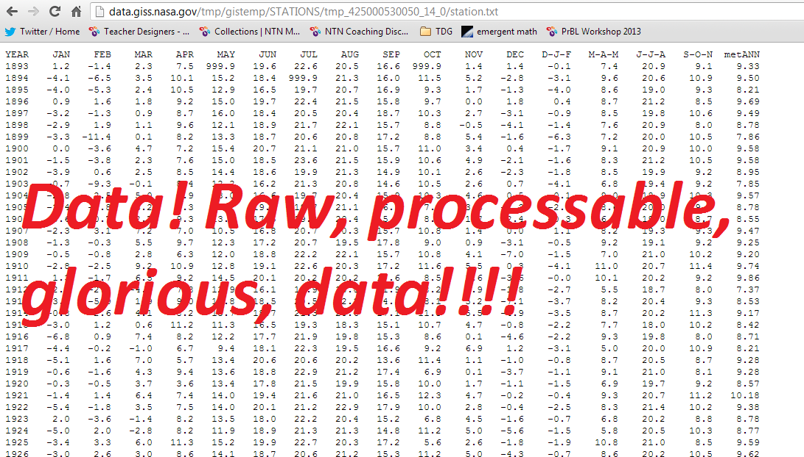
Data - From Raw to generic data formats
Raw data has not been subjected to:
Processing
Cleaning (e.g. removing outliers, device errors, or data entry errors)
Manipulation (Smoothing, transformations)
Analysis

Slide 22
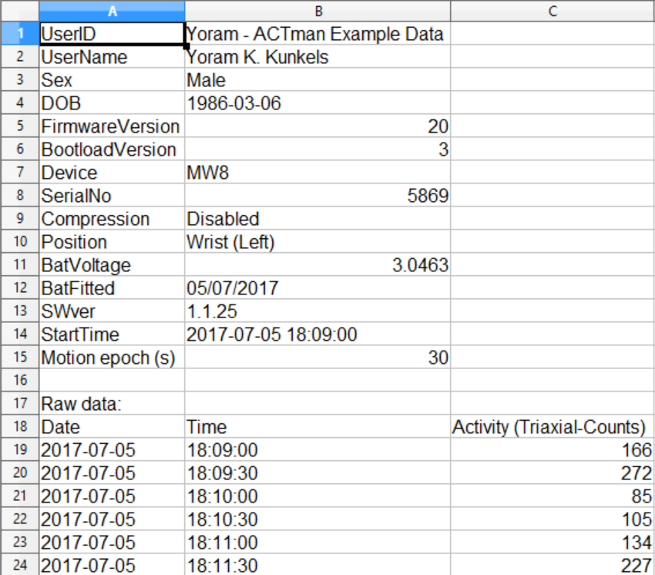
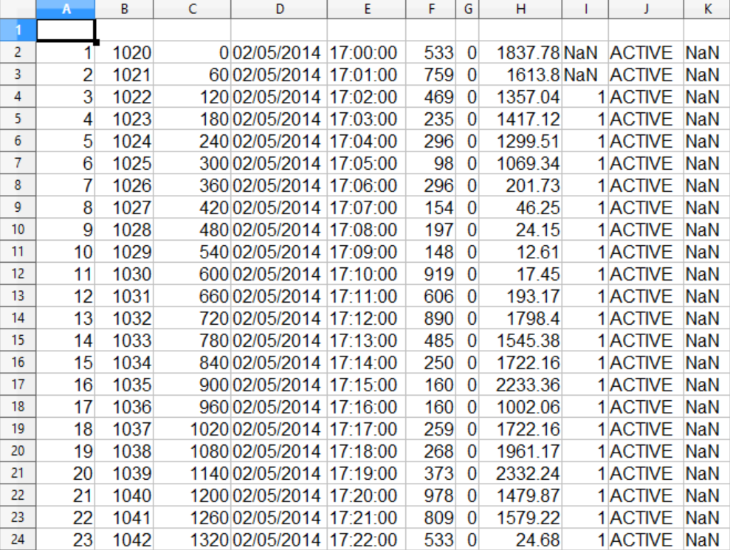
Data - From Raw- to generic data formats
Raw data might come in a multitude of formats

Slide 23
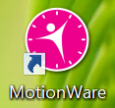
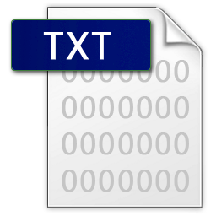
Data - From Raw- to generic data formats
Raw data might come in a multitude of Data types
.MTN files
.CSV files
.XML files
.TXT files
.BIN files
etc.

Slide 24
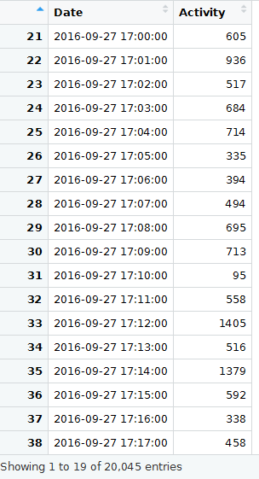
Data - From Raw- to generic data formats
But in the end only output with: 1) timestamp and 2) activity counts is needed.

Slide 25
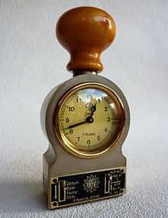
Pre-processing - Dates & times
These issues might be simple:
They might be due to different formatting by different devices:
“2017-01-16” or “2017/01/16” or “16-01-2017” or “16/01/2017”

Slide 26
Pre-processing - Dates & times
These issues might be hard:
Fallacy: Every day has 24 hours
Counter example: Because of daylight saving time (DST) some days could have 23 hours and some could have 25 hours. Or some other amount of hours - whole or not.

Slide 27
Pre-processing - Dates & times
These issues might be harder:
Fallacy: Week one of a year starts in January every year
Counter example: January 1st is not always a monday so some days of an ISO week will be in different years. Example: 2014 December 28th belongs to week 1 of 2015.

Slide 28
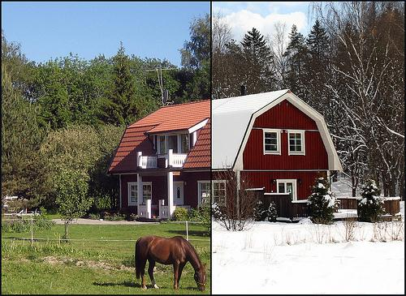
Pre-processing - Dates & times
Date/Time issues:
Dates format
Summer- / wintertime corrections
Timezone corrections
Solution: Use software which corrects for this (some
propietary- and open-source, but not all)

Slide 29
Pre-processing - Data Selection
Data selection considerations:
Do you want / need only full 24h parts?
When does a day in your data start and end;
From dataset start time (e.g. 2017-01-16 16:34:00)?
From midnight (e.g. 2017-01-16 00:00:00)?
What to do with non-wear at start and end?

Slide 30
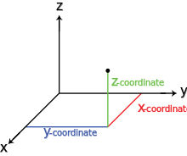
Pre-processing - Combining tri-axial Data
Combining tri-axial data
Early actigraphs: only one (vertical) axis.
Modern actigraphs: 3 axes.
But how to combine them (and should we want to)?

Slide 31
Pre-processing - Combining tri-axial Data
Combining tri-axial data
Just sum all axis counts (x + y + z)?
Vector Magnitude ((x^2 + y^2 + z^2)^(1/2))?
Use just 1 of the axes for analysis?

Slide 32
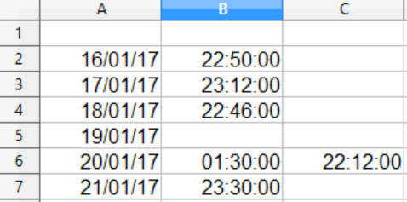
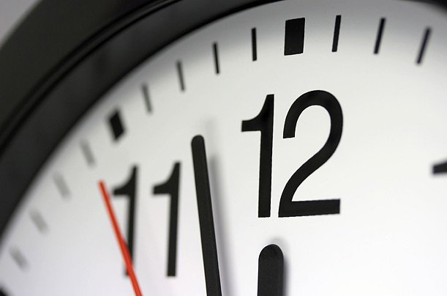
Pre-processing - Sleep times
Sleep start times (before after 00:00)

Slide 33
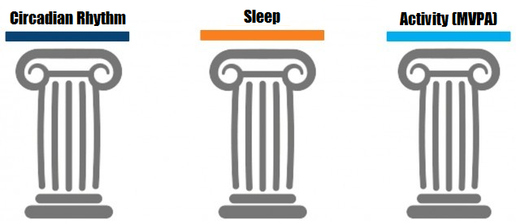
Analyses - Three Main Types

Slide 34
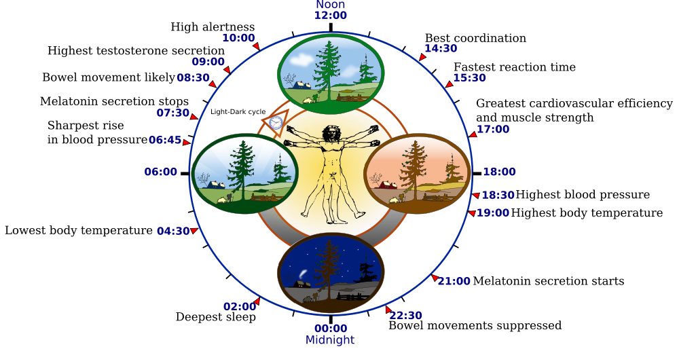
Analyses - Circadian Rhythm Analysis
Goal
Analyses of biological processes that display an endogenous, entrainable oscillation of about 24 hours

Slide 35
Analyses - Circadian Rhythm Analysis
Which kind of analyses to use?
Non-parametric versus parametric analyses
IS, IV, etc. versus e.g. Cosinor
No need for a priori waveform assumptions versus activity count free analyses
Notes:
An often used analysis method is cosinor analysis (e.g. Youngstedt, Kripke, Elliott & Klauber, 2001). In this method, a cosine curve with a period near or at 24-hours is fit to the data with the least squares method. However, a disadvantage of this and related analysis methods is their reliance on a priori assumptions about the waveform of the activity data.

Slide 36
Analyses - Circadian Rhythm Analysis
Outcomes & meaning
IS: Interdaily stability
IV: Intradaily variability
M10: 10 most active consecutive hours
L5: 5 least active consecutive hours

Slide 37
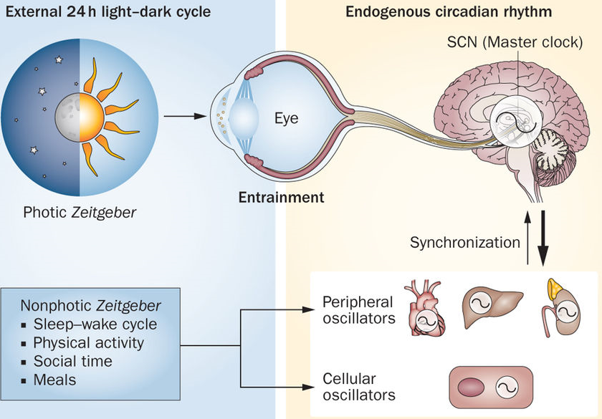
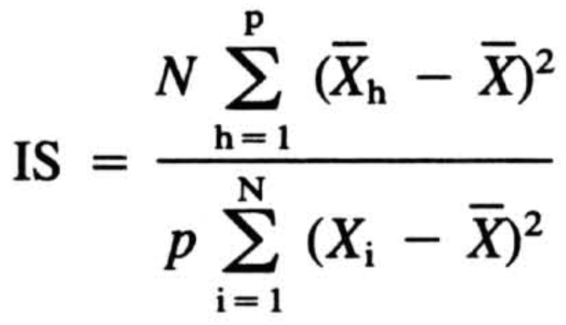
Analyses - Circadian Rhythm Analysis
Interdaily Stability (IS)
> IS indicates how strongly an individual’s rhythm is coupled to supposably stable zeitgebers (e.g. the 24-hour light/dark cycle, or the 12 month yearly cycle).
> Values range from 0 (very unstable) to 1 (very stable).
> High IS values were associated with older age,
better cognitive functioning, and less depressive
symptoms.
Notes:
The interdaily stability (IS) gives an indication of how strongly an individual’s rhythm is coupled to supposably stable environmental zeitgebers. These zeitgebers are cues that synchronise a person's biological clock to the 24-hour light/dark cycle of the Earth and the related 12 month cycle throughout the year. As such, the IS quantifies how much all recorded 24-hour activity rhythms are alike or, in other words, it shows the day-by-day regularity of the sleep-wake cycle. IS values range between 0 and 1 where 0 stands for a perfectly unstable rhythm and 1 stands for a perfectly stable rhythm. Older age was found to be associated with high IS scores, as were having better cognitive functioning and less depressive symptoms, whilst, lower IS scores were associated with being employed and being of the male gender (Luik, Zuurbier, Hofman, Van Someren & Tiemeier, 2013).

Slide 38
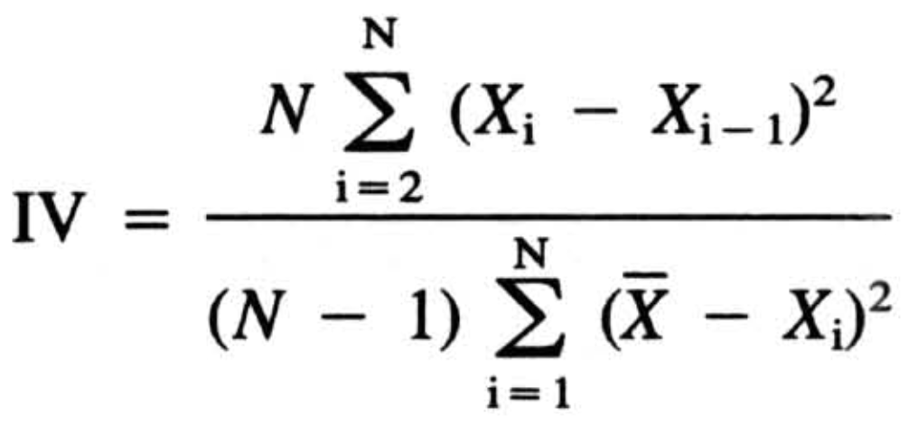
Analyses - Circadian Rhythm Analysis
Intradaily Variability (IV)
> IV indicates the fragmentation of rhythm and thus quantifies the frequency of transitions between rest and activity.
> IV values range from 0 (no fragmentation / perfect sine wave) to 2 (fully fragmented / pure Gaussian noise).
> High IV values were associated with high BMI, smoking, and having more depressive symptoms.
Notes:
The intradaily variability (IV) indicates the fragmentation of a person’s rhythm and thus quantifies the frequency and extent of transitions between rest and activity within a day. As such, high IV values might indicate daytime napping or extensive nocturnal activities. IV values normally range between 0 and 2, wherein 0 stands for no fragmentation at all (or a perfect sine wave) and 2 for a fully fragmented rhythm (or pure Gaussian noise). In rare cases IV values might exceed a value of 2, but such values only occur when a definite ultradian component with a period of 2 hours is present (van Someren et al., 1999). Low IV values correspond to being employed and being of the female gender. Conversely, high IV values often correspond to high BMI and smoking, whilst persons with depressive symptoms tend to score higher IV scores (Luik, Zuurbier, Hofman, Van Someren & Tiemeier, 2013).

Slide 39
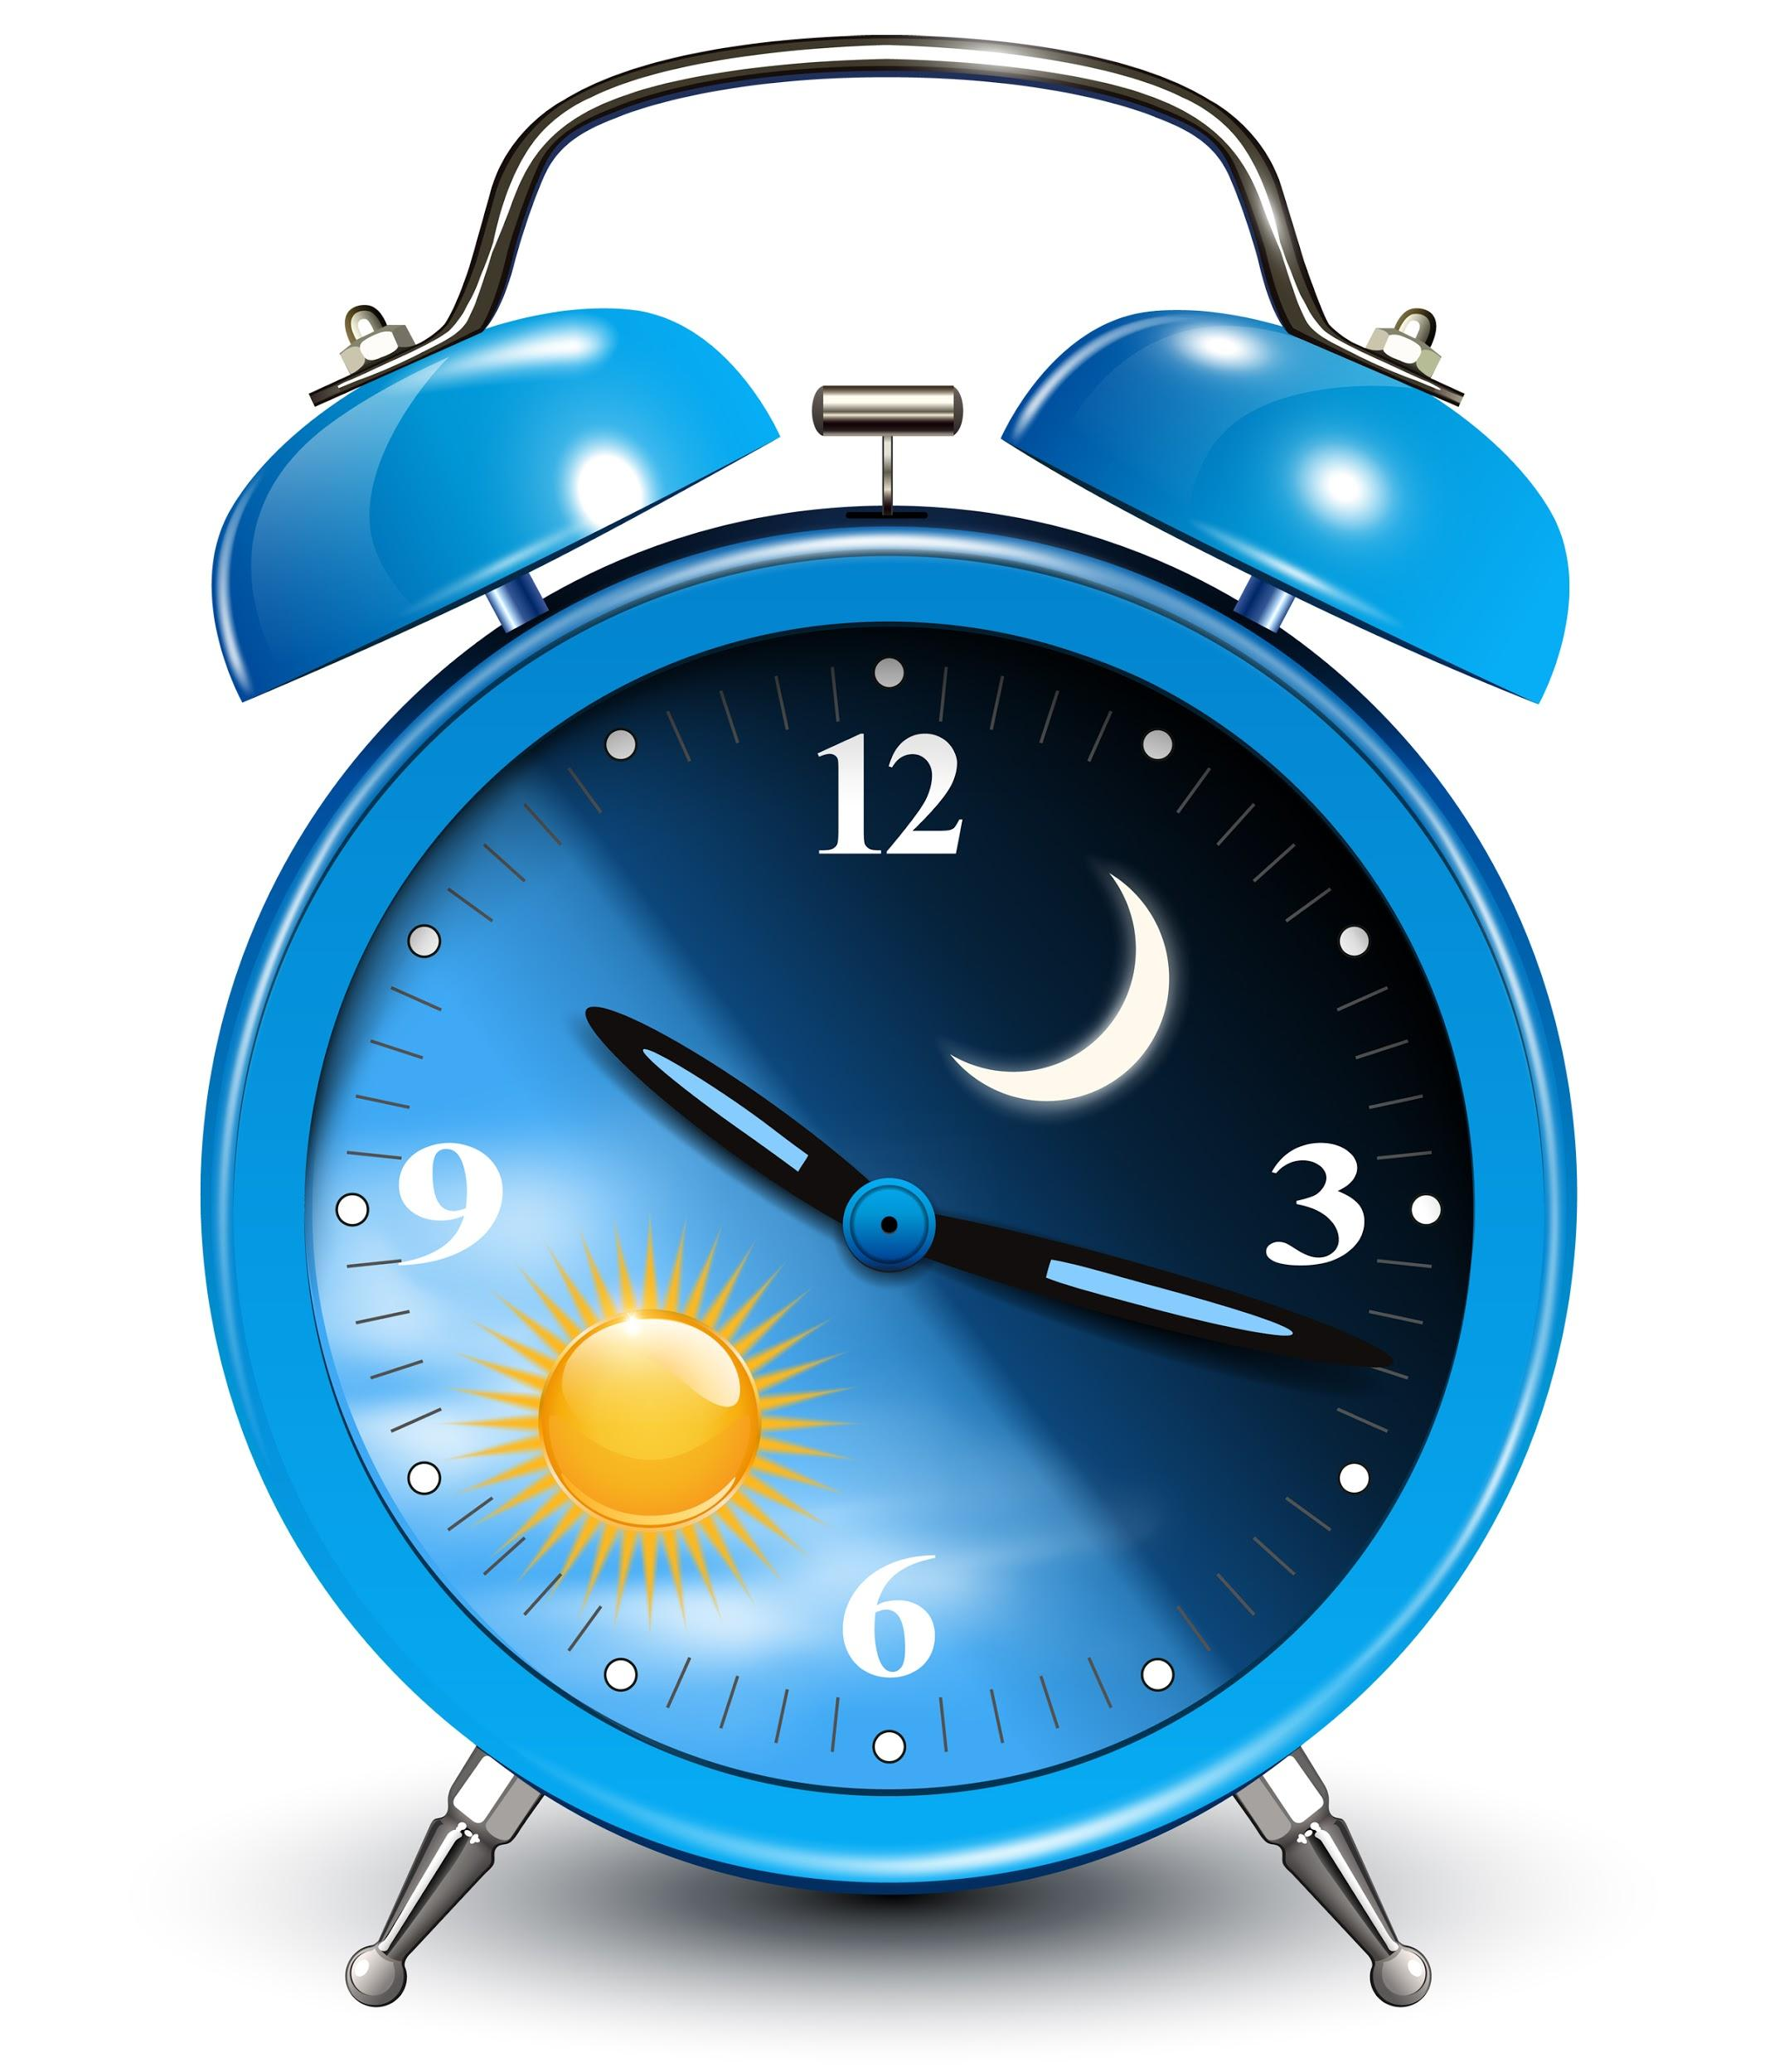
Analyses - Circadian Rhythm Analysis
10 highest consecutive hourly means (M10) &
5 lowest consecutive hourly means (L5).
M10 represent the 10 most active hours during the day.
L5 represent the 5 least active hours during the day.
Common Time-unit: 7-14 day Period
Notes:
M10 can be calculated by averaging the 10 highest consecutive hourly means, whilst L5 is computed by averaging the 5 lowest consecutive hourly means. M10 represents activity during the 10 most active hours during the day. L5, on the other hand, represents activity during the 5 least active hours. A non-parametric version of the relative amplitude (RA) of the rhythm can be derived from both the M10 and the L5 values as follows:

Slide 40
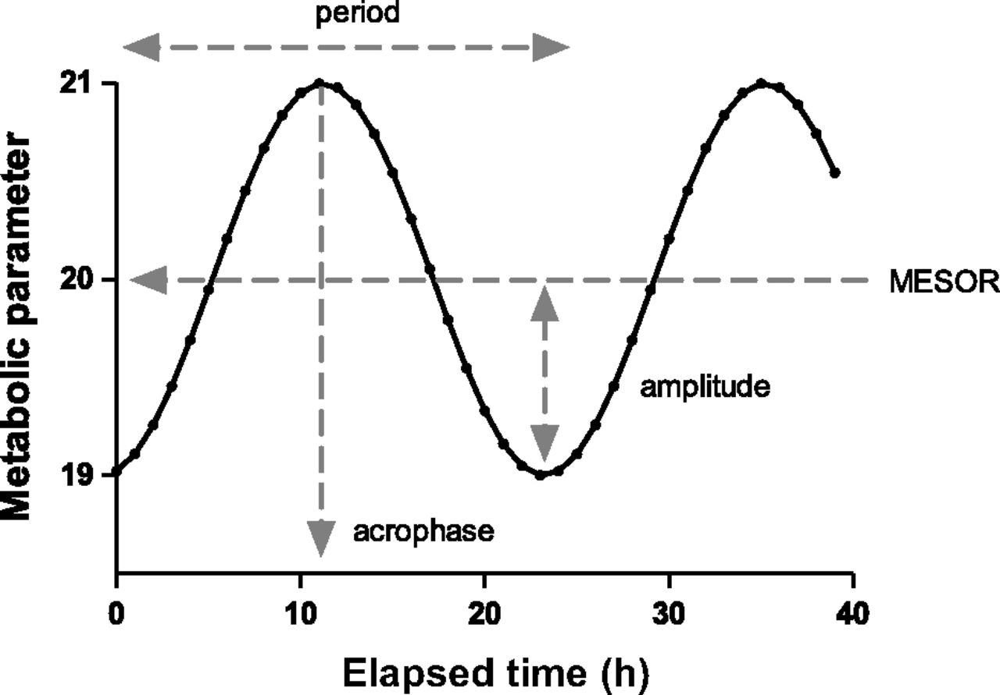
Analyses - Circadian Rhythm Analysis
Cosinor Analysis:
Uses least squares method to fit a sine wave to a time series. It is often used in the analysis of biologic time series that demonstrate predictable rhythms. This method can be used with an unequally spaced time series.
+ Activity count free
- Requires a priori knowledge about the wave function
Common Time-unit: 7-14 day Period

Slide 41
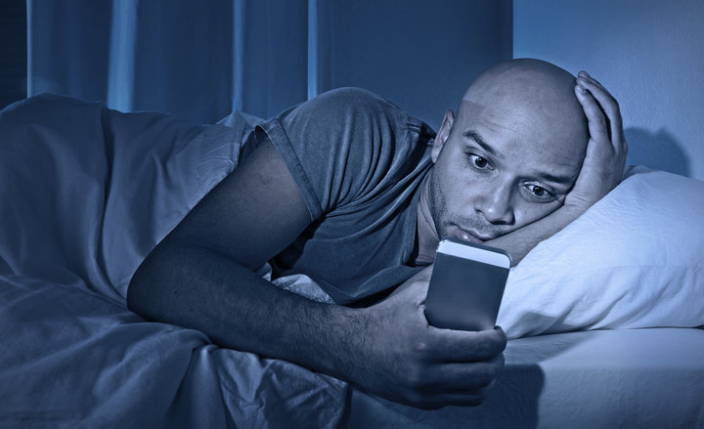
Analyses - Sleep Analysis

Slide 42
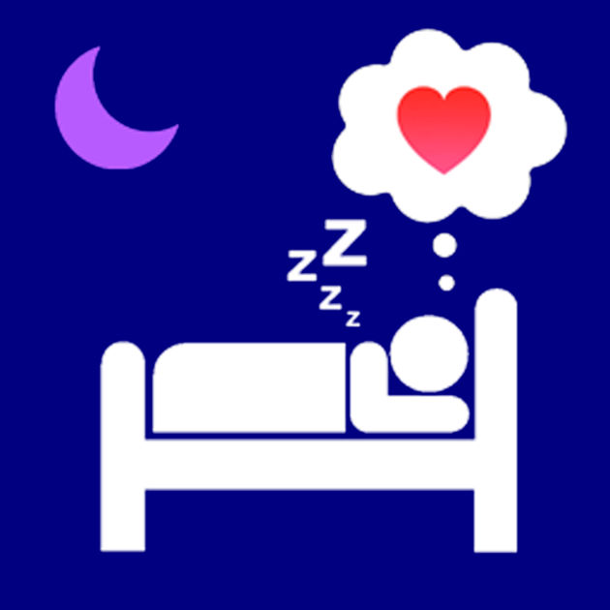
Analyses - Sleep Analysis
Goal
Recording and analysing body activity during sleep.
Diagnosis (e.g. sleep apnea, circadian rhythm sleep disorders, etc.)
Complement subjective- with objective measures

Slide 43
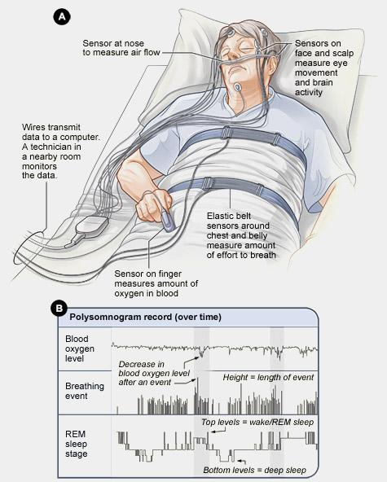
Analyses - Sleep Analysis
Polysomnography (PSG)
Golden Standard in Sleep Analysis
Invasive
Costly
Lab only / Impractical for Daily use

Slide 44
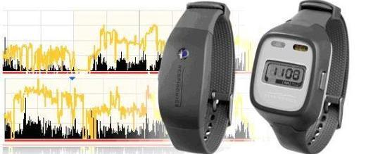
Analyses - Sleep Analysis
Actigraphy; Alternative method for Sleep Analysis
Non-invasive
Relatively Cheap
Suitable for Lab and Daily use
Validated against PSG

Slide 45
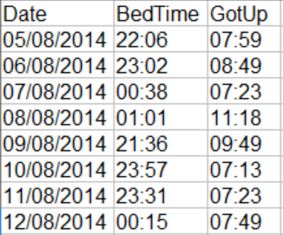
Analyses - Sleep Analysis
Identifying Sleep
Define period wherein sleep is likely to occur, using the sleep log.
Use the Sadeh Algorithm for calculating sleep likelihood; in the window every epoch is calculated as “sleep” or “wake” as follows: Activity score = Counts of the current epoch + counts of epoch before and after current epoch * 0.2 + counts of the epoch 2 before and 2 after epoch * 0.04.
Notes:
Identifying sleep
To calculate the sleep parameters the Sadeh algorithm for calculating likelihood of sleep is used in a stepwise manner. First the period is defined where sleep is likely to occur, using the sleep log. In the window every epoch is calculated as an ‘sleep’ or an ‘wake’ epoch by the following formula:
Activity score = Counts of the current epoch + counts of epoch before and after current epoch * 0.2 + counts of the epoch 2 before and 2 after epoch * 0.04.
When the activity score goes below an adjustable predefined value it will be scored as sleep epoch (below 20 for high sensivity, below 40 for medium sensitivity and below 80 for low sensitivity). Furthermore every epoch will be scored as mobile or immobile, mobile when it has four or more counts and immobile when it has less than four counts.

Slide 46
Analyses - Sleep Analysis
Identifying Sleep
3. When the activity score goes below an adjustable predefined value it will be scored as sleep epoch (below 20 for high sensitivity, below 40 for medium sensitivity and below 80 for low sensitivity). Furthermore every epoch will be scored as mobile or immobile, mobile when it has four or more counts and immobile when it has less than four counts.
Notes:
Identifying sleep
To calculate the sleep parameters the Sadeh algorithm for calculating likelihood of sleep is used in a stepwise manner. First the period is defined where sleep is likely to occur, using the sleep log. In the window every epoch is calculated as an ‘sleep’ or an ‘wake’ epoch by the following formula:
Activity score = Counts of the current epoch + counts of epoch before and after current epoch * 0.2 + counts of the epoch 2 before and 2 after epoch * 0.04.
When the activity score goes below an adjustable predefined value it will be scored as sleep epoch (below 20 for high sensivity, below 40 for medium sensitivity and below 80 for low sensitivity). Furthermore every epoch will be scored as mobile or immobile, mobile when it has four or more counts and immobile when it has less than four counts.

Slide 47
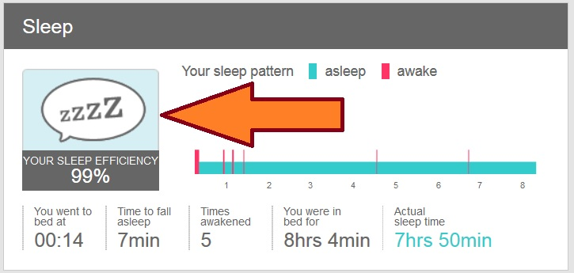
Analyses - Sleep Analysis
Outcomes & meaning
Assumed sleep: Total elapsed time between the "Fell Asleep" and "Woke Up" times.
Actual sleep time: Total time slept according to epoch-by-epoch wake/sleep scores.
Sleep efficiency: Actual sleep time expressed as a percentage of time in bed.
Sleep latency: The time between "Lights Out" and "Fell Asleep"

Slide 48
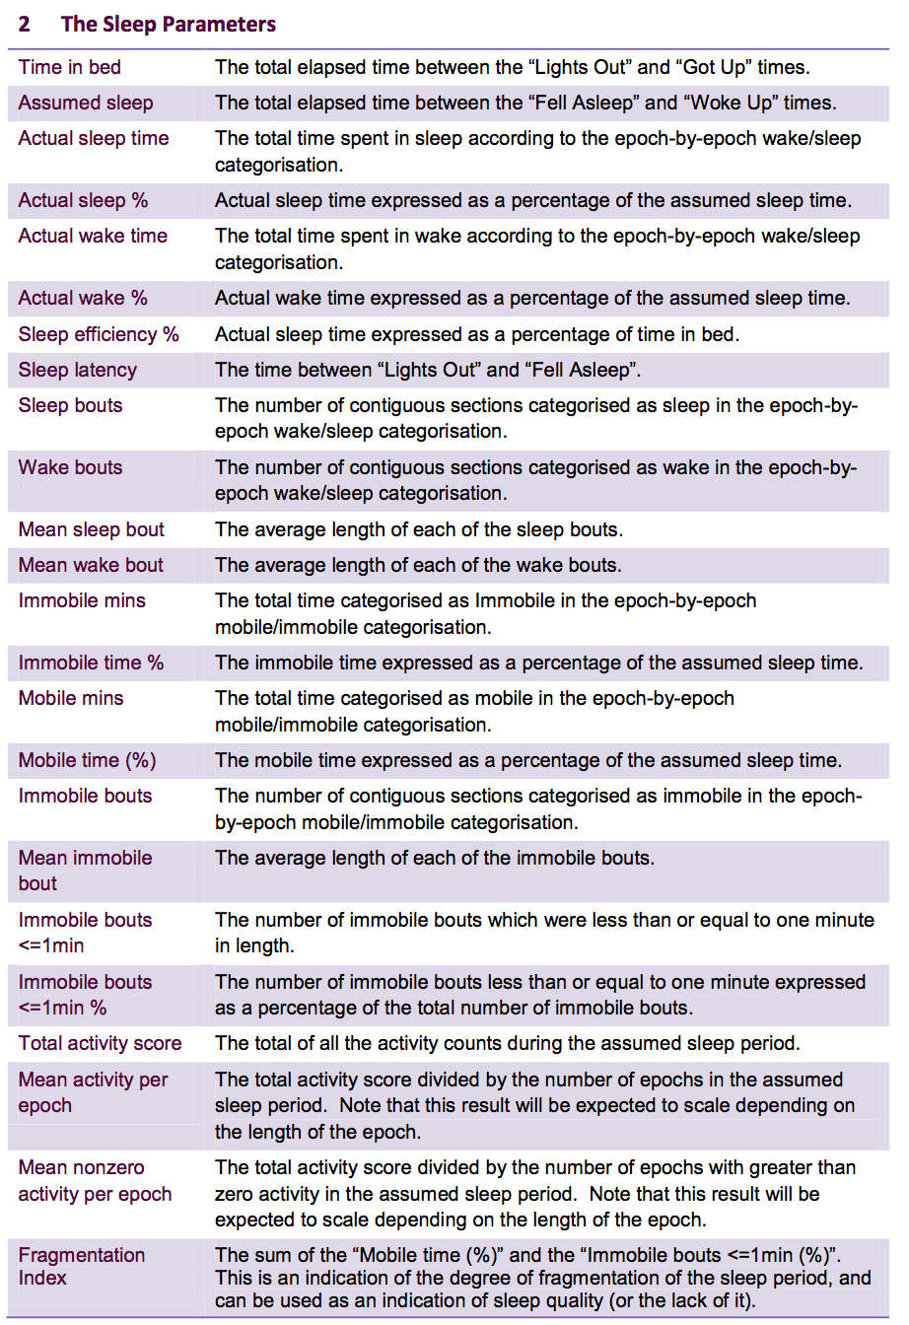
Analyses - Sleep Analysis
Outcomes & meaning
Many more Sleep Parameters obtainable.
But which are relevant for your study?
Which help you solve your research question?
Common Time-unit: 1 night / 24h Period

Slide 49
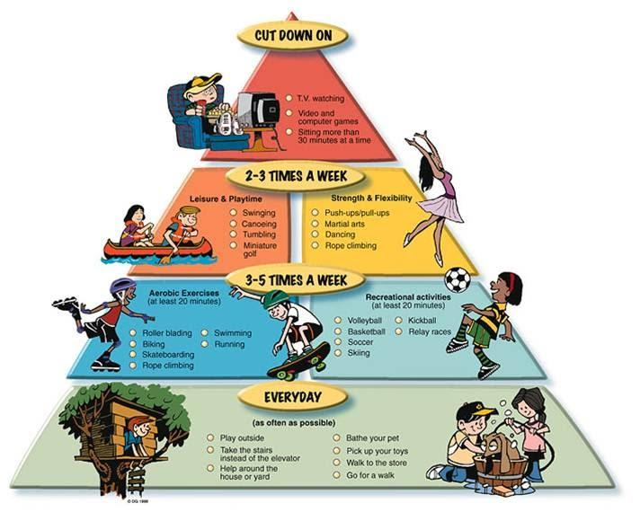
Analyses - Activity MVPA

Slide 50
Analyses - Activity MVPA
Goal
Analyse how active participants are and on what moments
Categorisation of Activity in bins:
Sedentary
Low intensity
Moderate intensity
Vigorous intensity

Slide 51
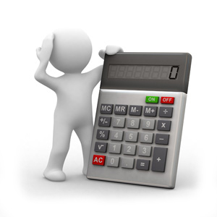
Analyses - Activity MVPA
Setting cut-off points
Receiver operator characteristics (ROC’s) analyses were performed to determine optimal cut-off points:
Sedentary (< 1.5 MET’s), Light (1.5 - 3.0 MET’s), and MVPA (> 3.0 MET’s).
MET = metabolic equivalents via Schofield-equations
Notes:
To derive MW8 activity count cut-points for healthy older adult PA levels for sedentary, light, moderate-to-vigorous activity: receiver operator characteristics (ROCs) analyses (Berk, 1976) were performed to determine optimal cut-points for the following PA intensities: sedentary activity (<1.5 METs), light activity (1.5–3.0 METs); MVPA (>3.0 METs)
MET = metabolic equivalents (METs) via Schofield-equations

Slide 52
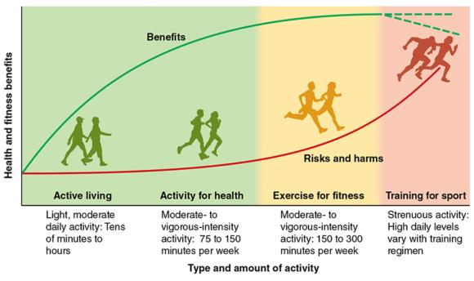
Analyses - Activity MVPA
Outcomes & meaning

Slide 53
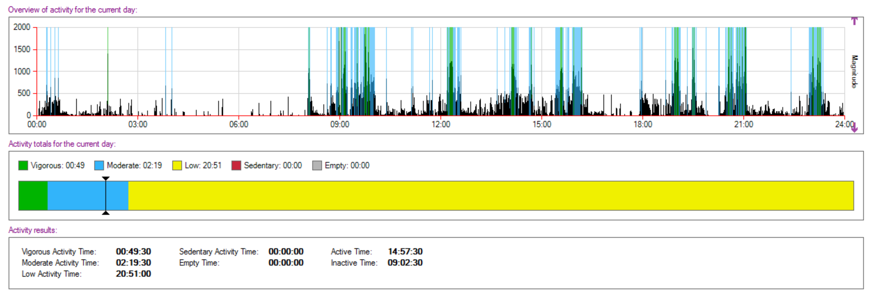
Analyses - Activity MVPA
Outcomes & meaning

Slide 54
Devices, Software, and Practical

Slide 55
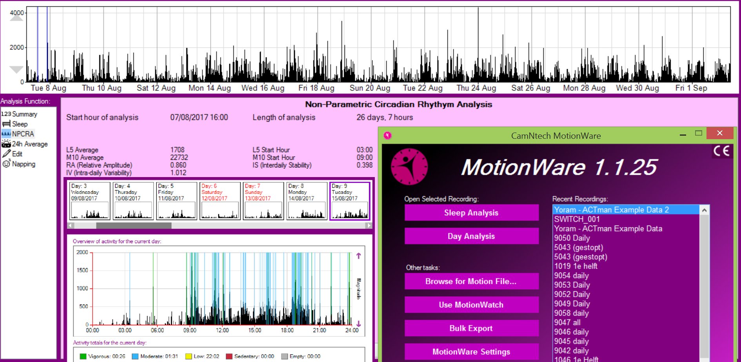
Devices and Software - Proprietary
MotionWatch8 & MotionWare
Actiwatch 2 & Actiware, etc.

Slide 56
Devices and Software - Open Source
R packages
nparACT: Non-Parametric Measures of Actigraphy Data
Actigraphy: Actigraphy Data Analysis
PASenseWear: Summarize Daily Physical Activity from 'SenseWear' Accelerometer Data
pawacc: Physical Activity with Accelerometers
PhysicalActivity: Process Physical Activity Accelerometer Data
acc: Exploring Accelerometer Data
accelerometry: Functions for Processing Minute-to-Minute Accelerometer Data
GGIR: Raw Accelerometer Data Analysis
HMMpa: Analysing accelerometer data using hidden Markov models
PAactivPAL: Summarize Daily Physical Activity from 'activPAL' Accelerometer Data
accelmissing: Missing Value Imputation for Accelerometer Data
ACTman

Slide 57
Comparison of Actigraphy Software
Comparing Circadian analysis results from 3 different actigraphy packages:
MotionWare (proprietary software)
nparACT package (R)
ACTman package (R)

Slide 58
Comparison of Actigraphy Software
MotionWare
Open Motion File called: “Yoram - ACTman Example Data”
Select Period from “2017-07-06 00:00:00” to “2017-07-20 00:00:00”

Slide 59
Comparison of Actigraphy Software
MotionWare
Check whether you have selected the right period (!)

Slide 60
Comparison of Actigraphy Software
MotionWare
Check out the Circadian Rhythm Analysis output.

Slide 61
Comparison of Actigraphy Software
ACTman & nparACT
Open R Studio by clicking on the icon

Slide 62
Comparison of Actigraphy Software
ACTman & nparACT
Fill in the right start- and end periods in ACTman.
Run the code (Ctrl + Enter).

Slide 63
Comparison of Actigraphy Software
ACTman & nparACT
Check out and compare the Circadian Rhythm Analysis Results!

Slide 64
Done Early?
More Fun Questions to Explore:
Explore Sleep- and Activity Analyses in MotionWare.
Using ACTman Moving Window functionality.
Compare different periods.

Slide 65
Room for Discussion

